Slide 1
Sarcasm Detection using Emojis and Sentiment Analysis on Play Store App Tweets
SIRAJAHAMED N D PES1201701496
AJEYA B S PES1201701604
AMRUTH KARNAM PES1201700266
UE17CS333 project submission

Slide 2
ABOUT THE PROJECT
Project idea:
With social media booming, there is always the increase of data. There is an exponential increase in the amount of data created every day.
One form of data is textual data. Social media platforms like Twitter host a huge amount of textual data.
During the past few years, there has been an increase in opinionated textual data in social media platforms like Twitter.
Many of the tweets are directed towards a person, a body or a company. The companies might want to know the reactions from the users’ side to make amends and thereby better their products. Sentiment analysis helps us in this cause.
In this paper, we go through the methods employed to analyze the sentiments of tweets of various playstore applications.

Slide 3
ABOUT THE PROJECT
Written text many of the times lacks the emotional perspective and the same feeling that a face to face conversation would have. This effect is nullified to an extent by the use of emojis.But nowadays , the emojis used in text are opposite to that of the emotion conveyed by the words in the text, that is, the emojis are used in a sarcastic manner.
Many algorithms which are used to detect sarcasm in textual data usually ignore the emojis, which adds a lot of weight to the overall emotion conveyed in the text.
In this paper, we also go through the methods used by us to recognize sarcasm in tweets with emojis.

Slide 4
UNIQUENESS ANALYSIS
The following in our project are somewhat uncommon in the projects we referred:
1) The number of data preprocessing techniques we have used are not there in the projects we referred. The data preprocessing we do in the beginning plays a pivotal role in the models producing good results.
2)In sentiment analysis, many of the approaches we have seen is a machine learning based approach. Many people consider Lexicon based approach to not perform as well as Machine Learning Based Models. Eventually in our project, we show that even Lexicon Based approaches provide good results and sometimes even better than Machine Learning algorithms.
3)In Sarcasm detection, RNN+CNN models, LSTM models have been tried. But we found that LSTM has some disadvantages like fixed length vectors. So, our model uses Attention Model along with LSTM, which is not very common.

Slide 5
DATASET SOURCE AND PREPROCESSING DONE
Dataset source
Dataset for Sentiment Analysis
- Source - Kaggle
- Link - https://www.kaggle.com/saiamogh/google-play-store-analysis/data
Dataset for Sarcasm Detection
-- Source - Github
- Link - https://github.com/jsubram/Sarcasm-Detection-Using-Emoji/tree/master/Data

Slide 6
DATASET SOURCE AND PREPROCESSING DONE
2. Pre-processing steps performed:
For both sections of our project, we have performed the following preprocessing steps:
Various tweets are filled with NaNs.
Such tweets are not of any use, so they are removed
Hashtags and URLs are removed from the tweets.
Non ASCII characters are removed.
Some common acronyms are converted to their full forms.
Spellchecker library is used so that some misspelled words are converted to the nearest meaningful word.
All tweets are converted to lowercase characters for homogeneity.
Word lemmatization is done, which leads to easier classification of tweets.
Stop Words are removed.

Slide 7
LITERATURE REVIEW
Preprocessing techniques:
https://www.researchgate.net/publication/273127322_Preprocessing_Techniques_for_Text_Mining
Vairaprakash Guruswamy and Subbu Kannan[1] mention the well-known preprocessing techniques for text mining. They mention the importance of preprocessing techniques like stop word removal, stemming, tokenization, which leads to the computer getting better data for processing from the previous unstructured data.
Limitation: The text we are dealing with are tweets, and they are definitely some acronyms, which are more meaningful if they are converted to their actual meanings. Also some hashtags exist referring to some names and organizations, which does not have any effect on sentiment analysis. So we choose to include these features along with the ones mentioned by Vairaprakash Guruswamy and Subbu Kannan.

Slide 8
LITERATURE REVIEW
Sentiment Analysis:
https://arxiv.org/pdf/1711.10377.pdf
Hamid Bagheri and Md Johirul Islam use Textblob as well for their sentiment analysis of twitter data.They also use tweepy library, but we choose to stick with Textblob and use K-Means along with textblob.
Sarcasm Detection:
https://www.aclweb.org/anthology/Y14-1047.pdf
Piyoros Tungthamthiti et al. use the SVM approach for sarcasm detection. But even with tri gram models which is the highest value of n taken, they arrive at 79% accuracy, and in their limitations, they say they could not handle words with #. So that provides an idea of removing hashtag from our data.

Slide 9
LITERATURE REVIEW
2) https://pdfs.semanticscholar.org/1baa/3f4fda7c92600a5c192adaed80a834d13ff9.pdf
Jeffrey Pennington et al. explain how GloVe Model works , how it is a term-term matrix rather than a term-document matrix, and shows how it performs better than other baseline models like Word2Vec.The GloVe model we use has 6 billion tokens and 300 dimensions.
3) https://www.aclweb.org/anthology/O18-1021.pdf
Jenq-Haur Wang et al. [5] mention how RNN might lead a vanishing weight or exploding weights problem, and hence suggest an approach where Word Embedding should be followed by LSTM for a better result. But with LSTM which have fixed length vectors, there ‘could’ be loss of some information. So, we use the Attention Model on top of LSTM, so that minimal information loss occurs.

Slide 10
LITERATURE REVIEW
4) https://pdfs.semanticscholar.org/7ac1/e870f767b7d51978e5096c98699f764932ca.pdf
C. Du, L. Huang [6] explains how Attention captures the best of both - keyword classification and neural network classification, as Attention assigns higher weight to some words compared to others. We are talking in the context of Soft Attention here, as Hard Attention would be focussed on one feature and it would be non deterministic. Attention model is tried on top of the LSTM model which leads to a good overall result.

Slide 11
HIGH LEVEL BLOCK DIAGRAM OF OUR IMPLEMENTATION
Sentiment Analysis:
Data Preprocessing
Tf - Idf of tweets
K-Means algorithm
Visualizations
Textblob approach
Performance metrics calculation

Slide 12
HIGH LEVEL BLOCK DIAGRAM OF OUR IMPLEMENTATION
Sarcasm Detection
Data Preprocessing
GloVe and Emoji2Vec
applied on tweets
Bidirectional LSTM Model
Visualizations
Attention + BiLSTM hybrid Model
Performance metrics calculation

Slide 13
THE MAIN CODE MODULES
Serial no | Code module description | Status (% complete) | What it does ?
 | For Sentiment Analysis
1 | Data Preprocessing | Complete | Various types of preprocessing of data tried. Those which improve the result are used before algorithms are used
2 | K-Means Algorithm | Complete | K-Means algorithm is applied to classify the tweets into the 3 categories. TF-IDF is applied on the tweets before applying K-Means
3 | Textblob approach | Complete | Textblob library is made use of, to classify the tweets into the 3 categories. The sentiment property of the library is made use, in order to classify the tweets
4 | Data visualizations and performance metrics | Complete | Many plots on the data and the results obtained are plotted. Data is plotted for each app too to make a comparative study. The accuracy, f1 score, recall and precision are calculated.
5 | User Input | Complete | The user provides in his tweet, and the result is provided if the tweet is having positive,neutral or negative sentiment.

Slide 14
THE MAIN CODE MODULES
Serial no | Code module description | Status (% complete) | What it does ?
 | For Sarcasm Detection
1 | Data Preprocessing | Complete | Various types of preprocessing of data tried. Those which improve the result are used before algorithms are used
2 | Bidirectional LSTM model | Complete | GloVe is used to vectorize the corpus, and provide the word embeddings to the LSTM model. 80/20 split done. In this model, the model gets insight about the context of both the past and future words, thus leading to better prediction.
3 | Bidirectional LSTM model + Attention hybrid model | Complete | Attention is applied on top of LSTM because the features given to the dense layers of the model for classification include only the last output state of the intermediate layers which becomes a bottleneck and it becomes very difficult to summarize all of the sentence in a single vector
4 | Data visualizations and performance metrics | Complete | Many plots on the data and the results obtained are plotted. Data is plotted for each app too to make a comparative study. The accuracy, f1 score, recall and precision are calculated.
5 | User Input | Complete | The user provides in his tweet, and the result is provided if the tweet is sarcastic or not.

Slide 15
MILESTONES THAT ARE DONE AND WORKING
Serial no | Milestone description | Status (% complete) | Comments
 | For Sentiment Analysis
1 | Literature Survey and data collection | Complete
2 | Preprocessing of data | Complete
3 | TF-IDF of tweets | Complete
4 | K-Means algorithm | Complete
5 | Textblob approach | Complete
6 | Data visualizations and Performance metrics | Complete

Slide 16
MILESTONES THAT ARE DONE AND WORKING
Serial no | Milestone description | Status (% complete) | Comments
 | For Sarcasm Detection
1 | Literature Survey and data collection | Complete
2 | Preprocessing of data | Complete
3 | GloVe applied on tweets | Complete
4 | Bidirectional LSTM | Complete
5 | Bidirectional LSTM + Attention hybrid Model | Complete
6 | Data visualizations and performance metrics | Complete

Slide 17
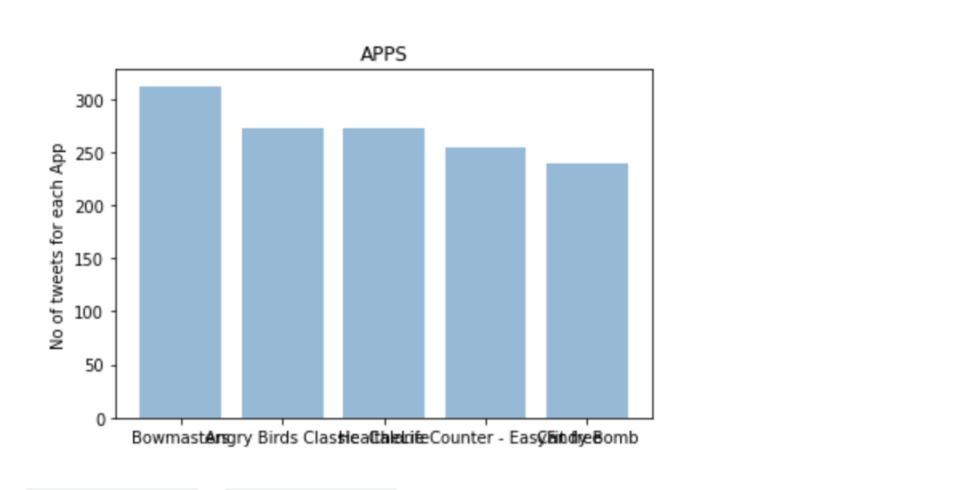
RESULTS OBTAINED
Sentiment Analysis:
Visualizations:
Initially, a bar chart of apps vs number of tweets is plotted. But as there are more than 800 applications, a bar chart is shown which has the tweets vs number of tweets for the top 5 apps.
Plots:

Slide 18
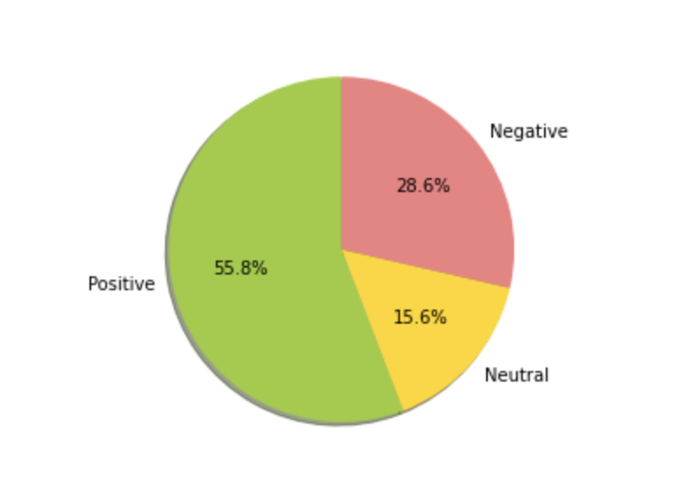
RESULTS OBTAINED
A pie chart is plotted which has the division of the predicted sentiments of the tweets.
Also, after predictions are done for each application, a pie chart is plotted having the division of the tweets.

Slide 19
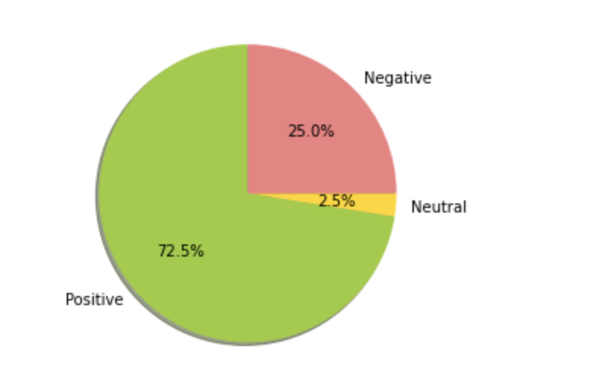
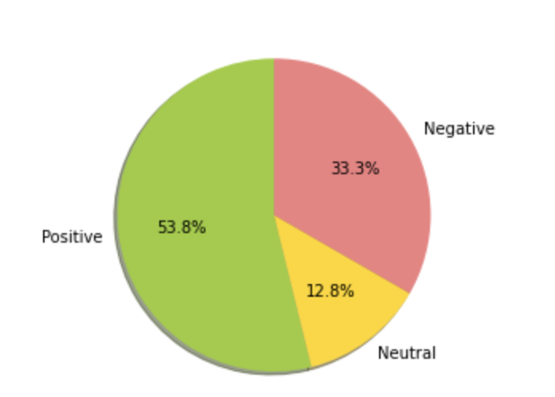
RESULTS OBTAINED
As an example, the pie chart is shown for two applications.

Slide 20
RESULTS OBTAINED
Performance Metrics:
K-Means Algorithm:
Accuracy -> 60%
F1 Score ->26 %
Precision ->31 %
Recall ->22%
TextBlob Approach:
Accuracy -> 85%
F1 Score -> 80%
Precision -> 83%
Recall -> 85%

Slide 21
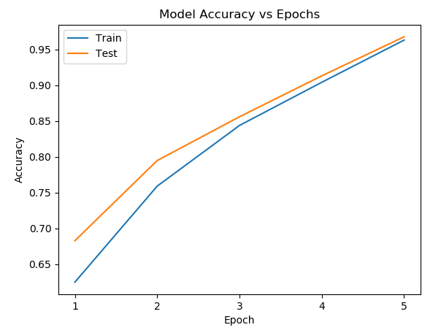
RESULTS OBTAINED
Sarcasm Detection:
Visualizations:

Slide 22
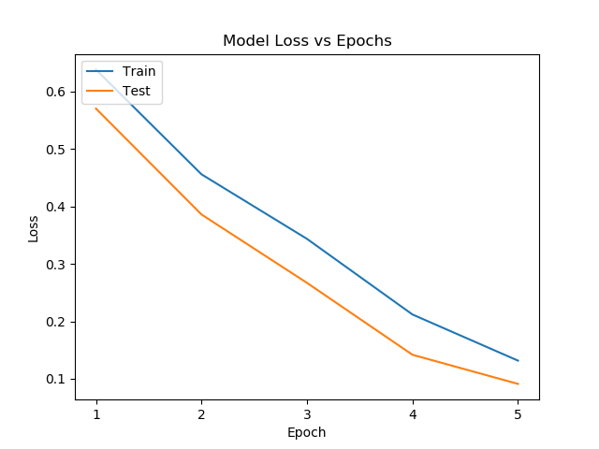
Visualizations:

Slide 23
RESULTS OBTAINED
Performance Metrics:
Bidirectional LSTM Model:
Accuracy -> 87%
F1 Score -> 86%
Precision -> 83%
Recall -> 89%
Bidirectional LSTM + Attention Hybrid Model :
- Accuracy -> 96.5%
F1 Score -> 96%
Precision ->96%
Recall -> 96%

Slide 24
OUR TOP LEARNINGS IN THIS PROJECT
We understood the power of data preprocessing and data visualization techniques. For all the algorithms and models, we initially just applied the model without preprocessing the data. The results obtained for all the models were bad. But after preprocessing the data,
we got accuracy as high as 97% for some models. Visualization helped us catch some intricate details of the data which help us understand it more.
2. We learnt that Machine Learning models need not always be the go-to model for real world natural language problems. Lexicon based approaches sometimes give better results than ML based approaches.
3. We got to know that the attention model works well with LSTM for Sarcasm Detection purposes.
4. K-Means algorithm after all may not be a good approach to take for sentiment analysis problems.

Slide 25
TOP CHALLENGES UNRESOLVED SO FAR
K-Means is giving just 60% accuracy, and the other metrics are worse. Given that ML algorithms usually fare better, and also given that we have done all types of preprocessing and used sophisticated approaches like TF-IDF to convert the categorical data to numerical form, and taken ideal number of clusters, this remains a mystery as to why it performed so bad.
The reason could be that K-Means is a clustering algorithm, and this leads us to the direction where we could say that clustering algorithms are not good models in Sentiment Analysis.
It is tough to make a hybrid model out of K-Means and Textblob.
That is, given that one of them is an ML based approach and the other a Lexicon based approach, blending them with one another could lead to worse results.

Slide 26
OUR PLAN GOING FORWARD
We have seen that clustering algorithms do not work well for Sentiment Analysis.
As part of the Machine Learning based approach, classification algorithms like Random Forests can be applied on the data to see if any improvements are seen compared to algorithms like K-Means.
We have seen that the Textblob approach performs pretty well on the data. If the classification algorithms perform well, the Lexicon based model and the Machine Learning based model can be combined into a hybrid model to test if the overall performance of the model increases.

Slide 27
THANK YOU
Sirajahamed N D - SRN - PES12101701496
Ajeya B S - SRN - PES12101701604
Amruth Karnam - SRN - PES12101700266

